Slide 1

TBA2104 Predictive Analytics Order Brushing Predictive System Group 10
Choo Shu Min (A0227117L)
Wong Kwok Cheong (A0211279H)
Yeoh Amy (A0227095B)

Slide 2
TABLE OF CONTENTS
Introduction
01
Process Overview
02
Data Download/Preparation
03
Data Modelling, Analysis and Findings
04
Logistic Regression
Conclusion
05
Support Vector Machine
Random Forest
Naives Bayes

Slide 3
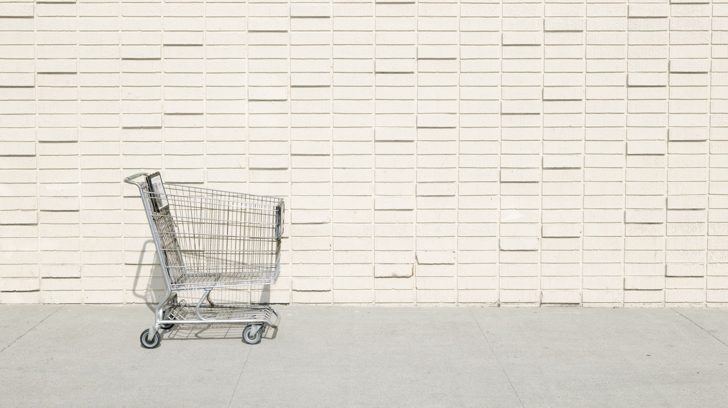
Introduction
Order brushing

Slide 4

Order Brushing
Definition: Generating fake orders in an attempt to boost their shop’s rating and can be done by placing/and or completing a fake order through a third party and posting a positive rating or review to artificially increase the credibility of the item purchased.

Slide 5
Order Brushing Predictive System
Business domain – E commerce
To identify characteristics of Order brusher based on dataset
Highlighted order brusher will be flagged for further investigation

Slide 6

Overview: Data Analytics Process

Slide 7
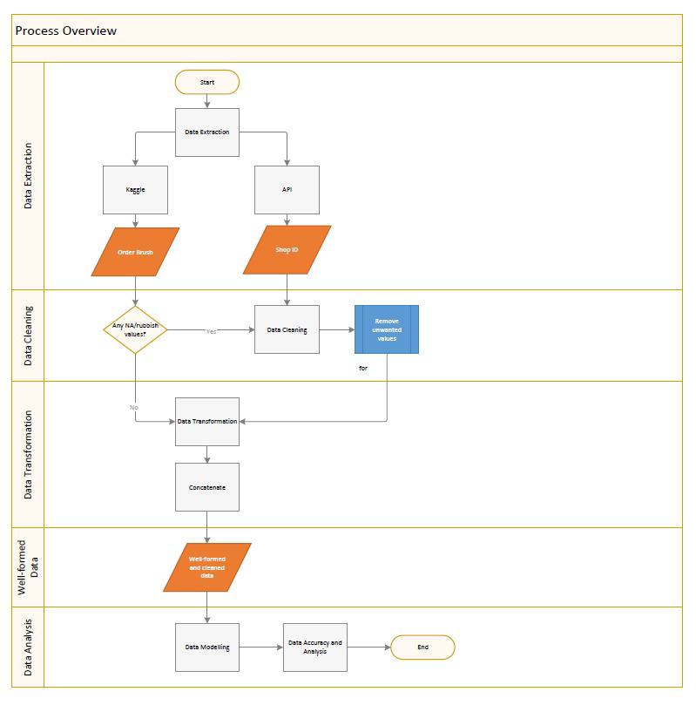
Process Overview
Data Extraction via API
Data Cleaning/Transformation
Data Analysis

Slide 8

Data Download/Extraction
Data Source: Kaggle and API
Dataset 1: Order Brush
Dataset 2: ShopID

Slide 9


Data Download
Data source: https://www.kaggle.com/datasets/davydev/shopee-code-league-20?resource=download
API to extract Shop Information from Shopee

Slide 10
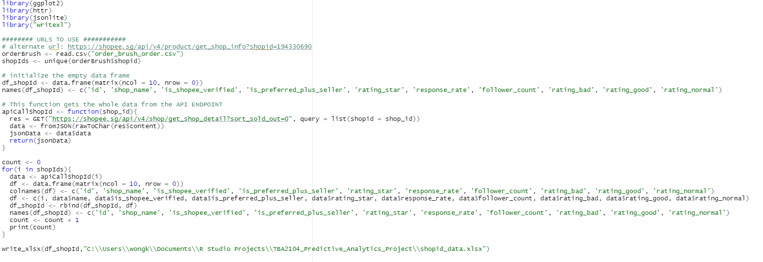
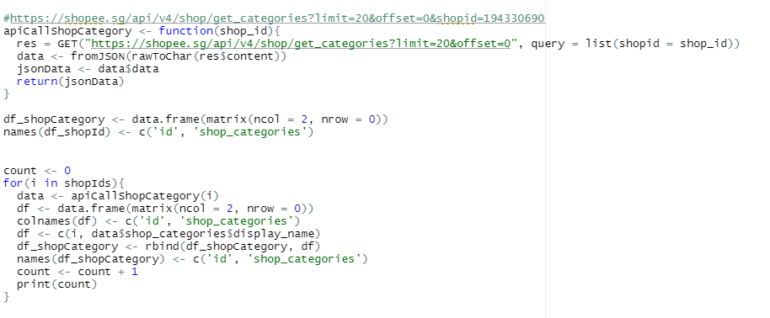
Data Download: API

Slide 11

Data Preparation
Data cleaning and transformation process

Slide 12

Data Cleaning: Order Brush Dataset
Dataset is checked for:
NA values
Empty fields
Dataset downloaded is of quality, hence not much cleaning required

Slide 13
Data Cleaning: ShopID Dataset
Data are cleaned using excel.
Ensure values are within the following range and remove the rest:
Rating Stars: within 1 - 5
Shop Response: between 1 to 100
Preferred: Yes or No
Verified: True or false

Slide 14
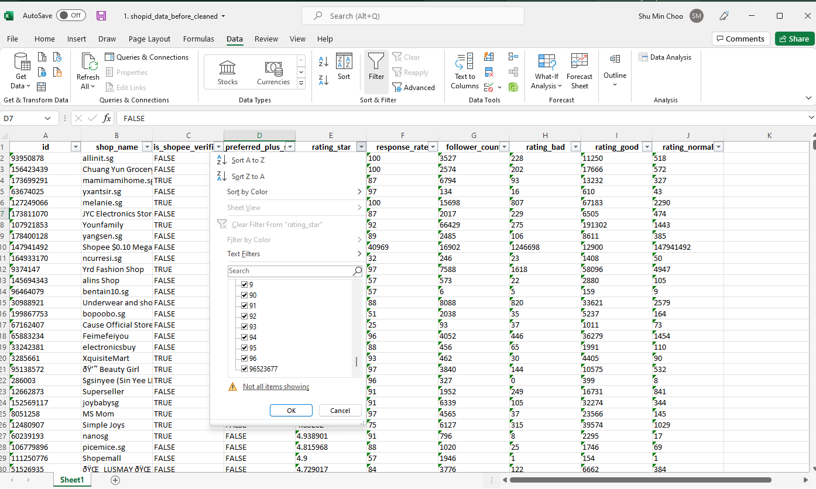
Data Cleaning: ShopID Dataset
Value should be true or false

Slide 15
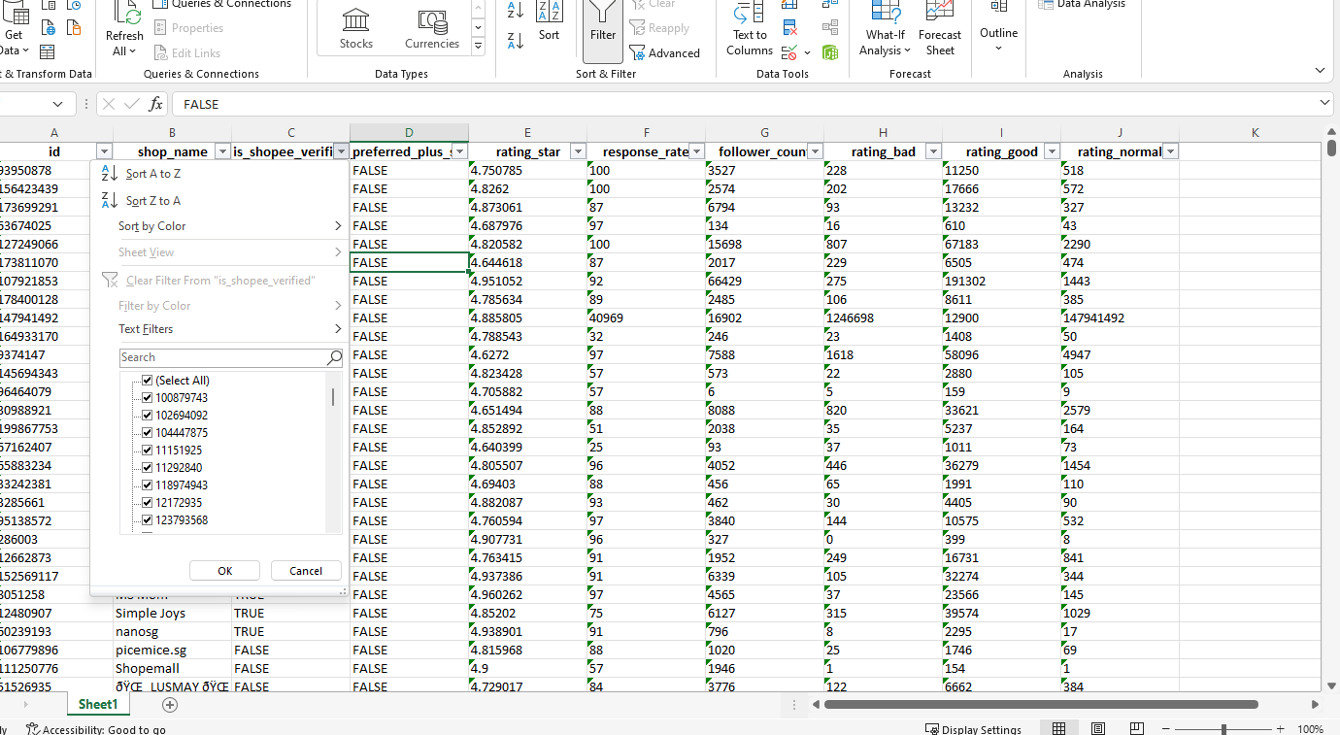
Data Cleaning: ShopID Dataset
Value should be true or false

Slide 16
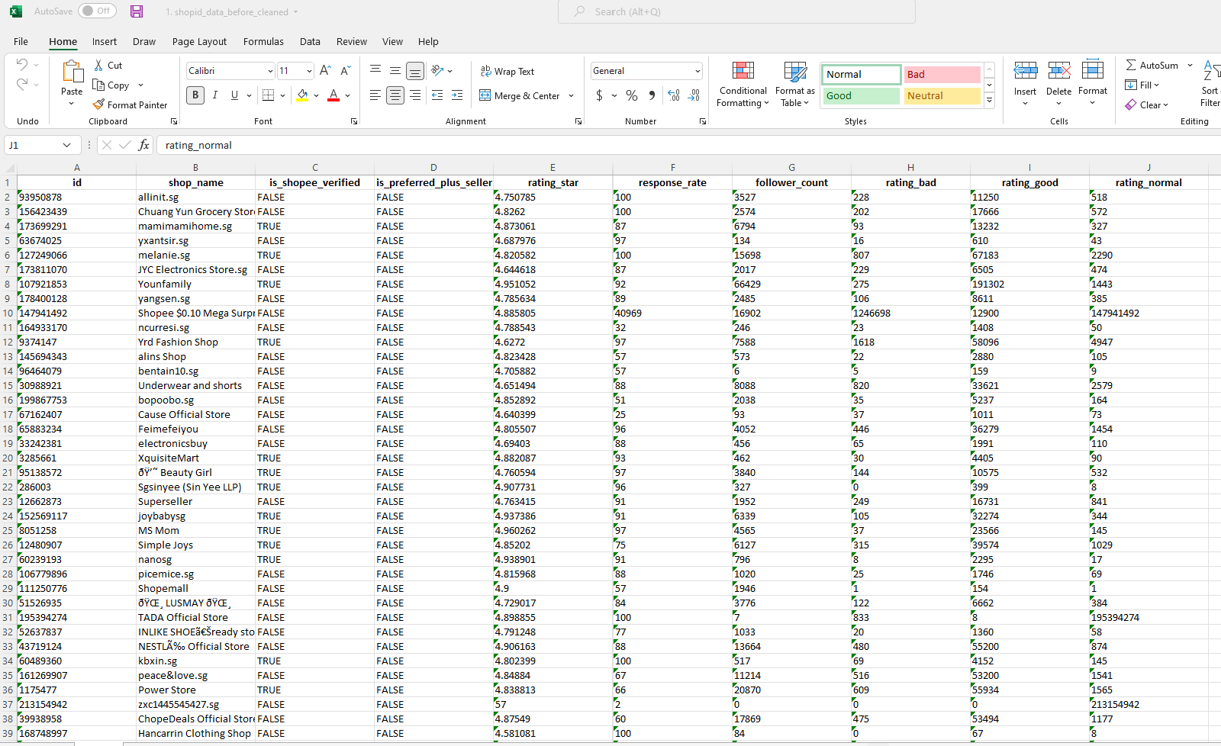
Data Cleaning: ShopID Dataset
Value should be within 1 to 100

Slide 17

Data Transformation

Slide 18
Data Transformation: Order Brush Dataset
Loading dataset into R
Concatenate 'shopid' and 'userid'
Set 'event_time' in date and time format
Arrange 'shopid_userid' by ascending order
Identify duplicated values in 'shopid_userid'
Identify 'shopid_userid' with multiple orders place
Identify frequency of order for the 'shopid_userid'
Identify those with more than 3 orders
Calculate the time difference between each row (in seconds) and assign zero to first row
Identify orders placed within an hour (3600 seconds)
1 - order place within an hour
0 - order place not within an hour
Calculate the frequency of 'shopid_userid'
Identify order with frequency of more than or equal to 2
1 - No order brushing
Order brusher based on shopID obtained
2 or more - order brushing

Slide 19
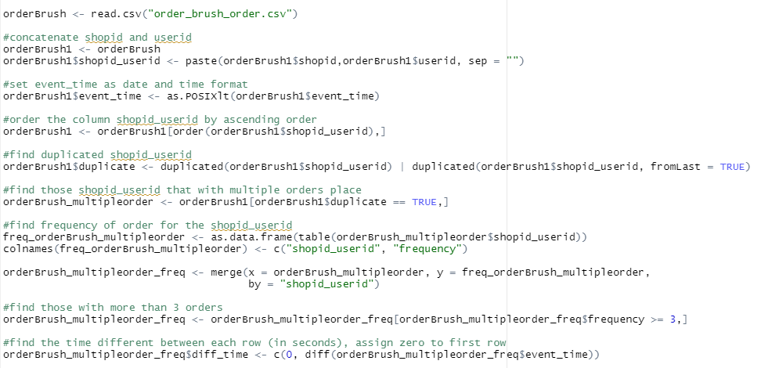
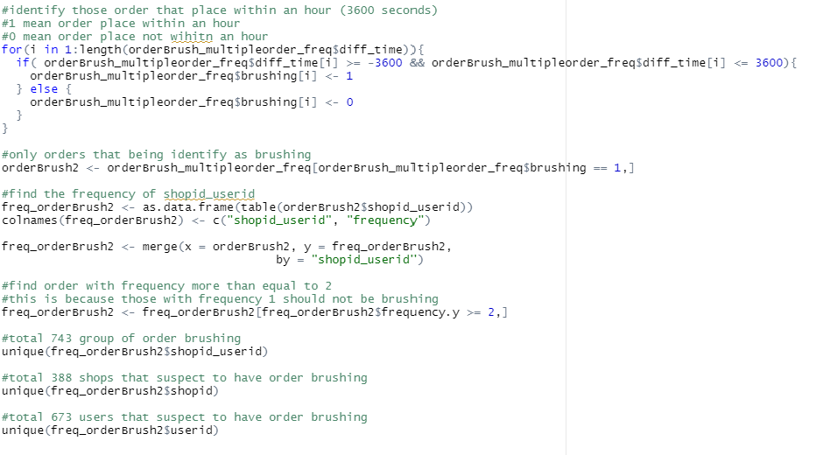
Order Brush Dataset: R codes

Slide 20

Well-formed data

Slide 21
Combining Order Brush and ShopID Dataset
The Order Brush and ShopID dataset are combined into one with the help of xlookup() function
With the cleaned and well-formed data, it will be ready for further analysis:
Logistic Regression
Support Vector Machine
Random Forest
Naives Bayes

Slide 22

Data Pre-processing: Order Brush and ShopID Dataset
Dataset loaded into r
Check for classification and reclass
Split the data into train (75%) & test (25%)
SMOTE, 10-Fold CV
Data Tuning – Normalization

Slide 23
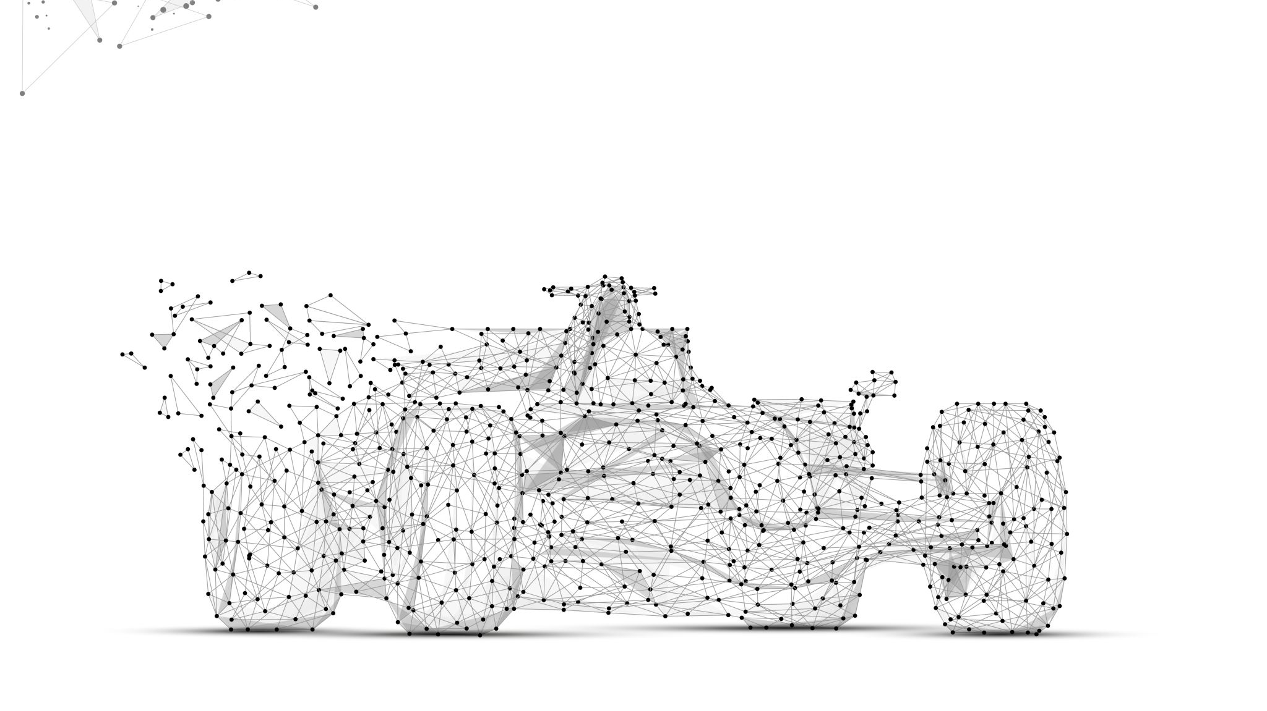
Data Modelling, Analysis and Findings
Logistic Regression
Support Vector Machine
Random Forest
Naïve Bayes
Notes:
Moving on to data modelling and analysis

Slide 24
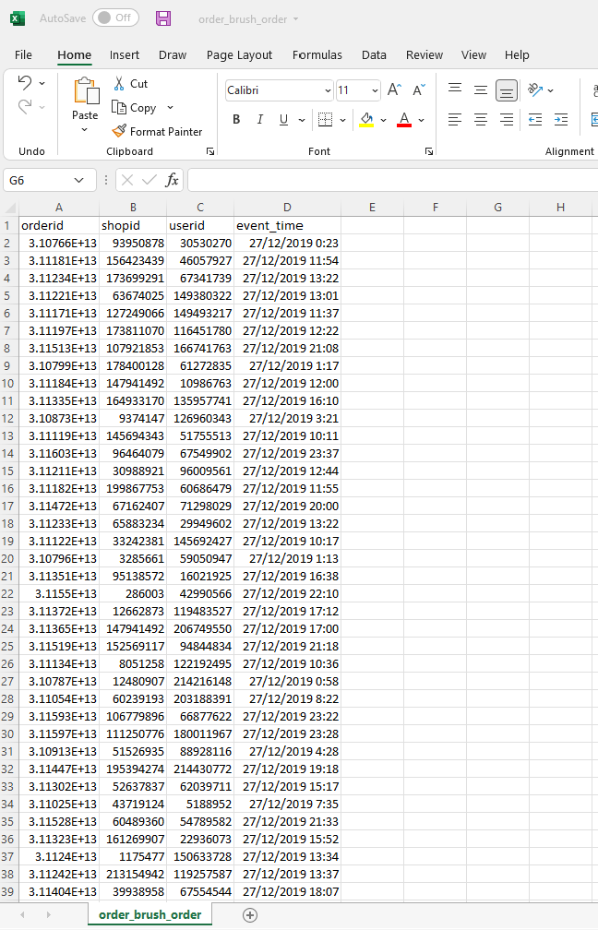
Overview
Orderbrush Dataset Contains:
OrderID
ShopID
UserID
Event_time

Slide 25
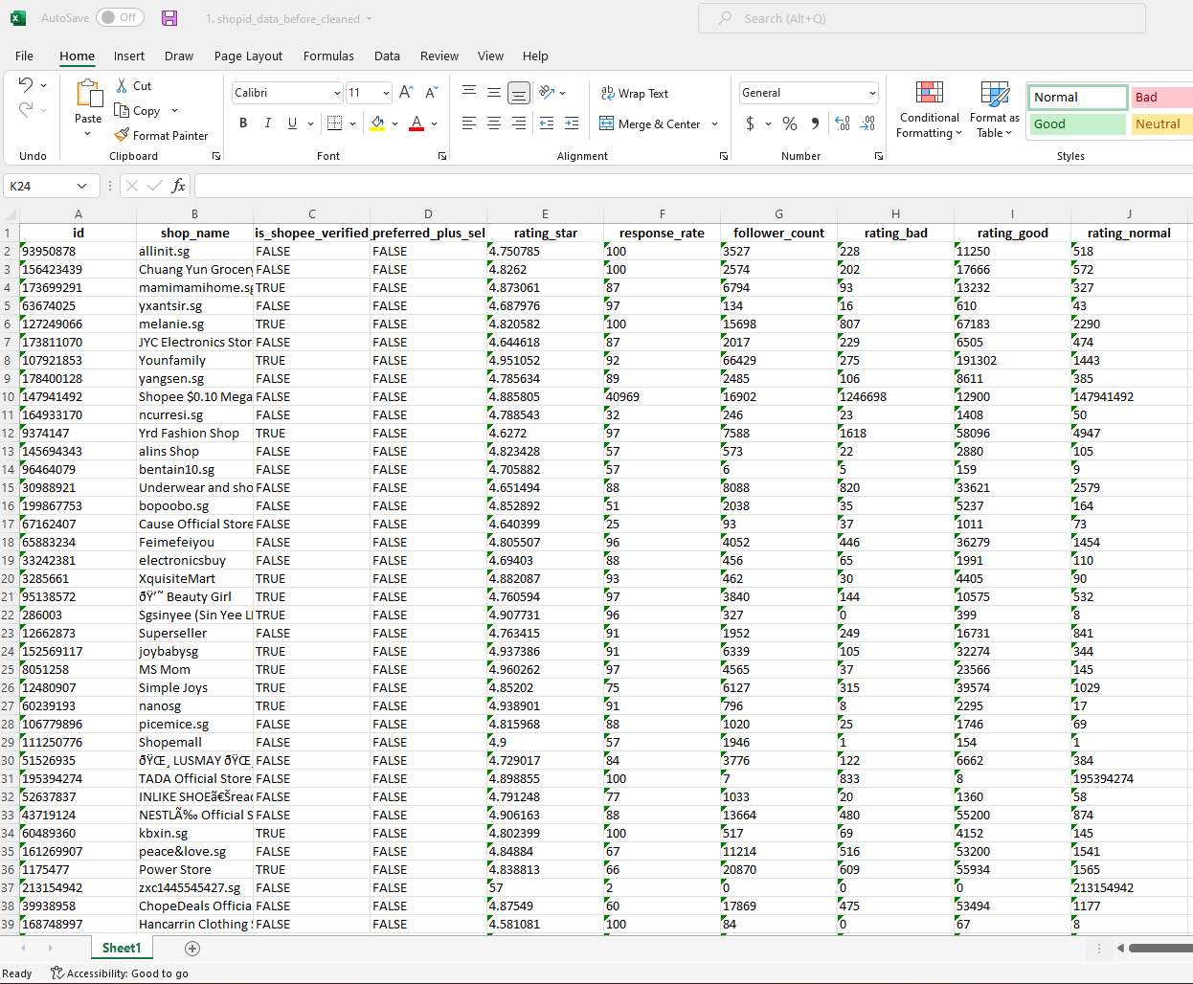
Overview
ShopID Dataset Contains:
ShopID
Shop Name
If shop is verified*
If shop is preferred**
Shop Rating
On a scale of 1 to 5, 5 being the best
*Verified refer to account verification with contact number/email
**To qualify for ‘preferred’, seller has to meet a certain criteria and invited by Shopee

Slide 26
Overview
ShopID Dataset Contains:
Shop response rate*
Shop follower count
Total no. of Bad Ratings
Total no. of Good Ratings
Total no. of Normal Ratings
*Response rate refers to seller’s chat response rate to buyer

Slide 27
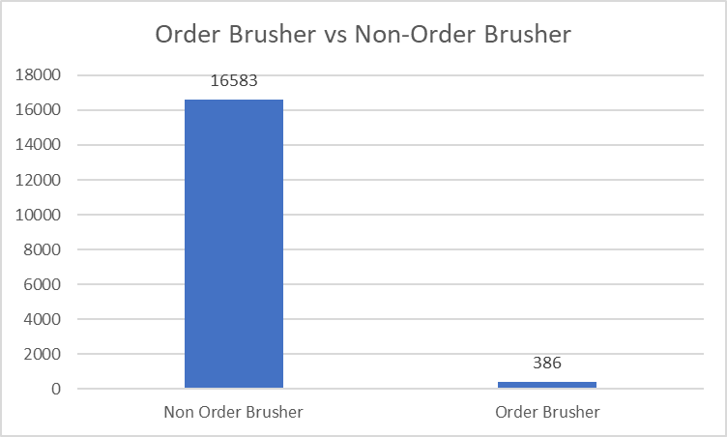
Data Visualization
16,970 shop information in dataset
8% of shop is verified
387 (2%) identified as order brusher
None of the shop is under preferred seller programme

Slide 28
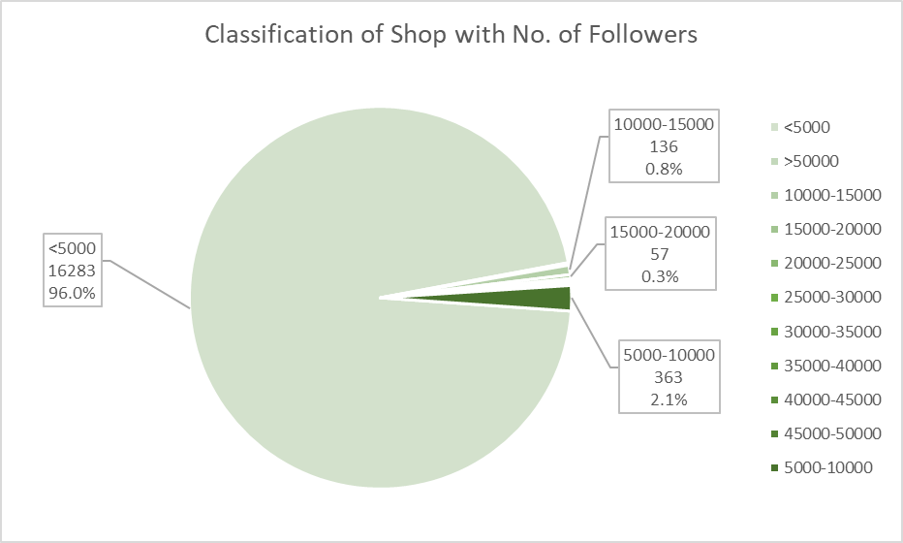
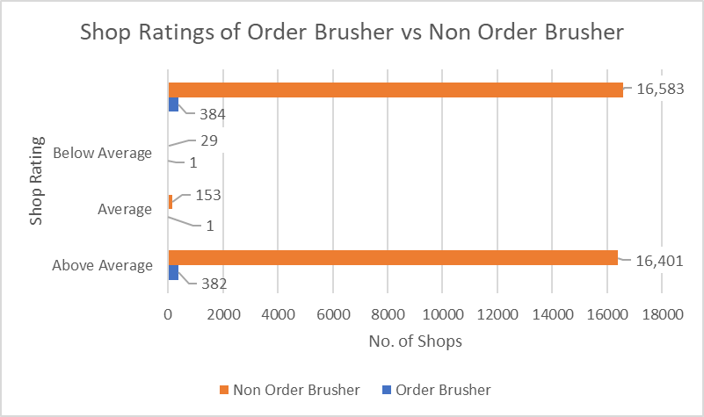
Data Visualization
Majority (96%) of the seller have followers less than 5000
Majority of the identified order brusher have shop ratings of above average

Slide 29

Logistic Regression
models the probability that Y belongs to a particular category

Slide 30
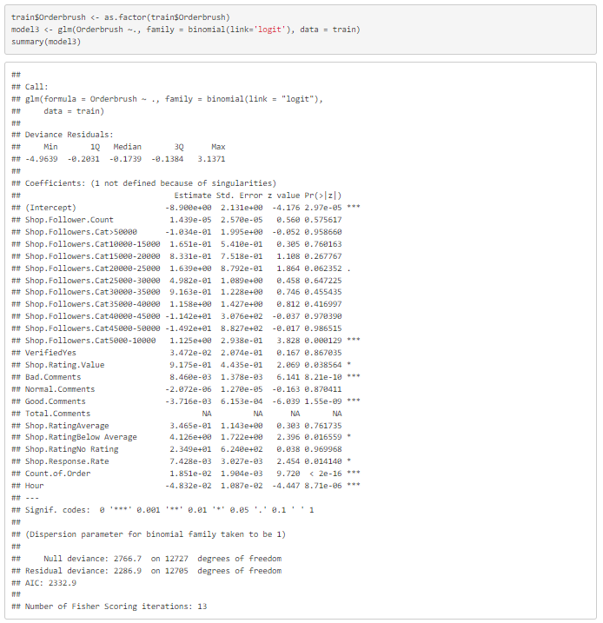
Logistic Regression: First Method
Data was splitted into test and train datasets.
We used the glm function with family = binomial to fit the model.
Variables like bad comments, count of order, hour and etc are statistically significant.

Slide 31
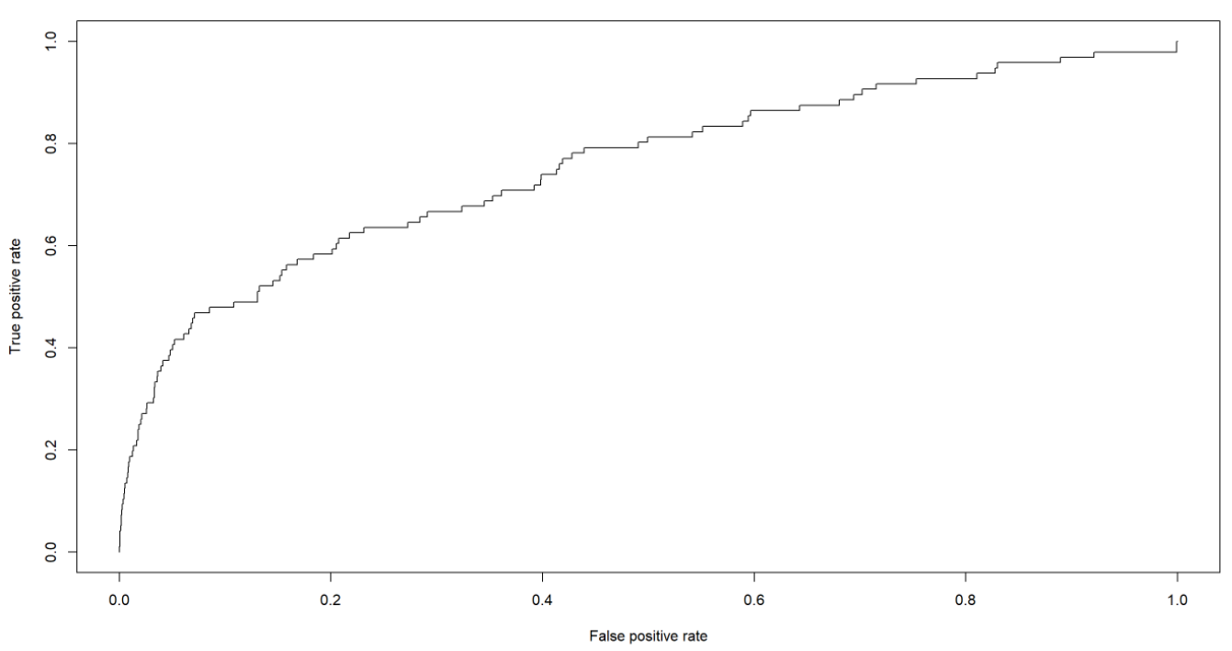
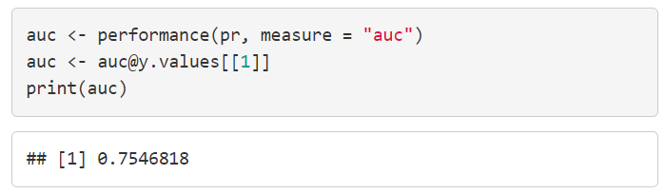
Logistic Regression: Model Accuracy
Receiver Operator Characteristic (ROC) curve closer to the top-left corner indicate a better performance.
Area Under the Curve (AUC) between 0.5 to 1 mean the model with good predictive ability.

Slide 32
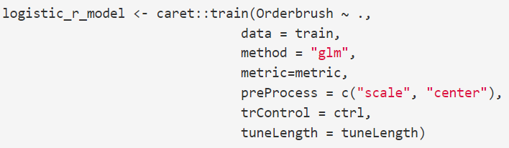
Logistic Regression: Second Method
Performed data tuning and pre-processing.
We used 'glm' method which specifies that we will fit a generalized linear model.

Slide 33
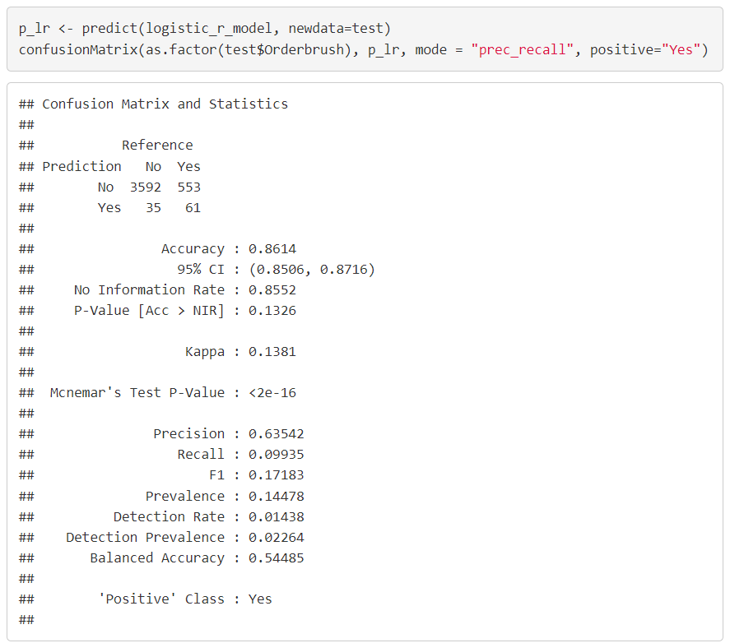
Logistic Regression: Model Accuracy
Out of 96 "Yes", the model predicted 61 "Yes".
Precision: 0.63542
Recall: 0.09935

Slide 34
Logistic Regression: Model Limitation
Logistics Regression can only be used to predict binary outcome
Logistics Regression assume linearity between dependent and independent variables.

Slide 35

Support Vector Machines
Extension of maximal margin classifier to accommodate non-linear class boundaries
Intended for binary classification setting
Notes:
The support vector machine is a generalization of a simple and intuitive
classifier called the maximal margin classifier ,
cannot be applied to most data sets, since it requires that
the classes be separable by a linear boundary.
maximal margin classifier
that can be applied in a broader range of cases.

Slide 36
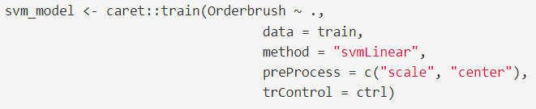
Support Vector Machines: Linear Classifier
The variables are normalized to make their scale comparable.
Tuning parameter C (Cost) is to determine the possible misclassifications. We used the default C = 1.

Slide 37
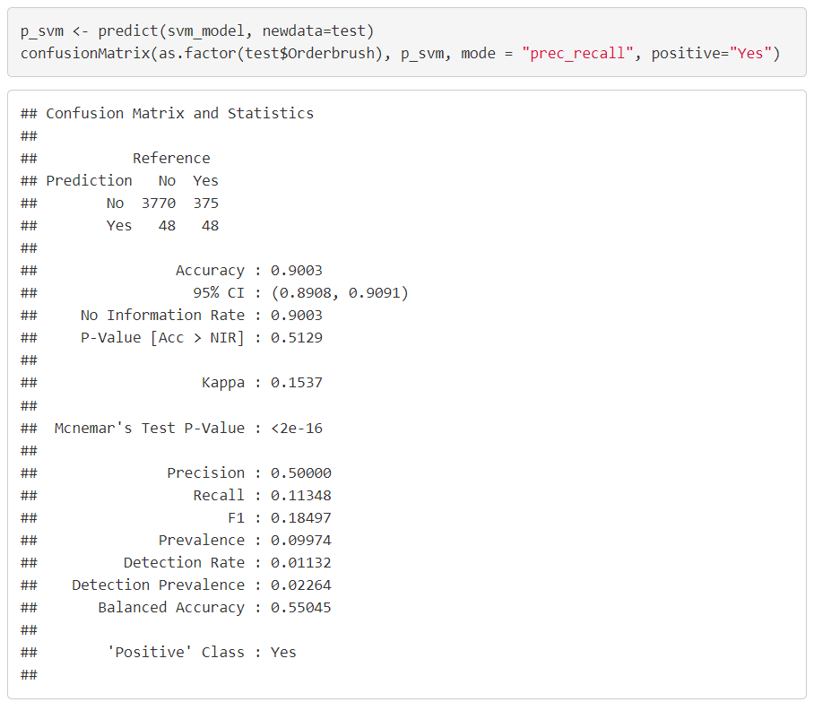
Support Vector Machines: Model Accuracy
Out of 96 "Yes", the model predicted 48 "Yes".
Precision: 0.5
Recall: 0.11348

Slide 38
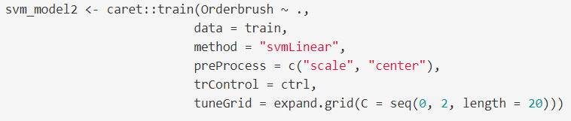
Support Vector Machines: Linear with Choice of Cost
Computed SVM for a grid values of C and choose automatically the final model for predictions.

Slide 39
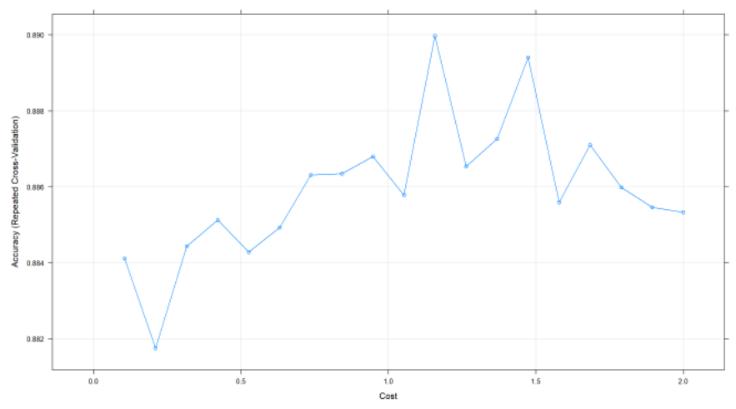
Support Vector Machines: Model Accuracy
The best tune choice of
C = 0.2105263

Slide 40
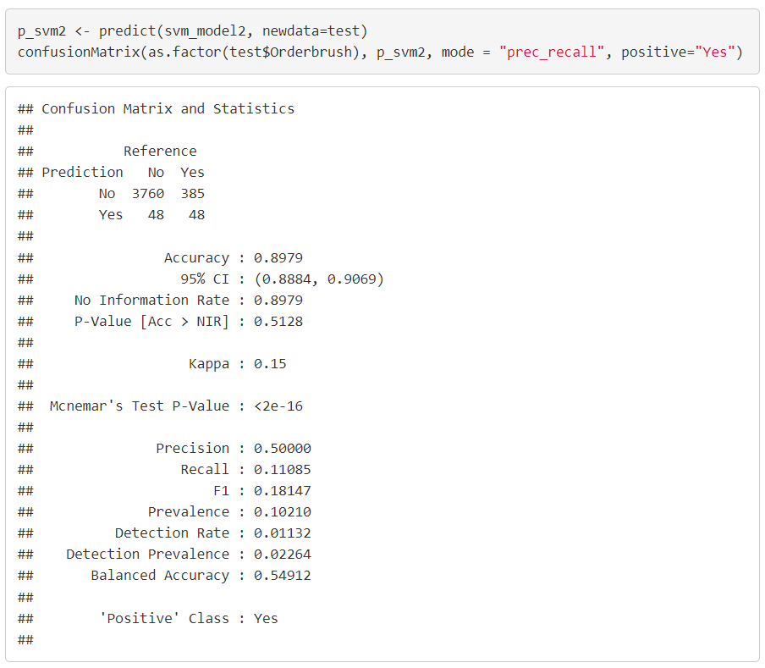
Support Vector Machines: Model Accuracy
Out of 96 "Yes", the model predicted 48 "Yes".
Precision: 0.5
Recall: 0.11085

Slide 41
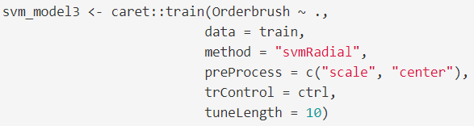
Support Vector Machines: Non-Linear Kernel (Radial)

Slide 42

Support Vector Machines: Model Accuracy
Out of 96 "Yes", the model predicted 70 "Yes".
Precision: 0.72917
Recall: 0.07315

Slide 43
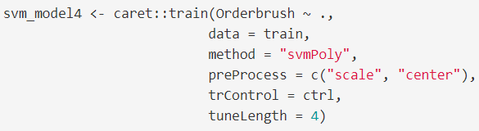
Support Vector Machines: Non-Linear Kernel (Polynomial)

Slide 44
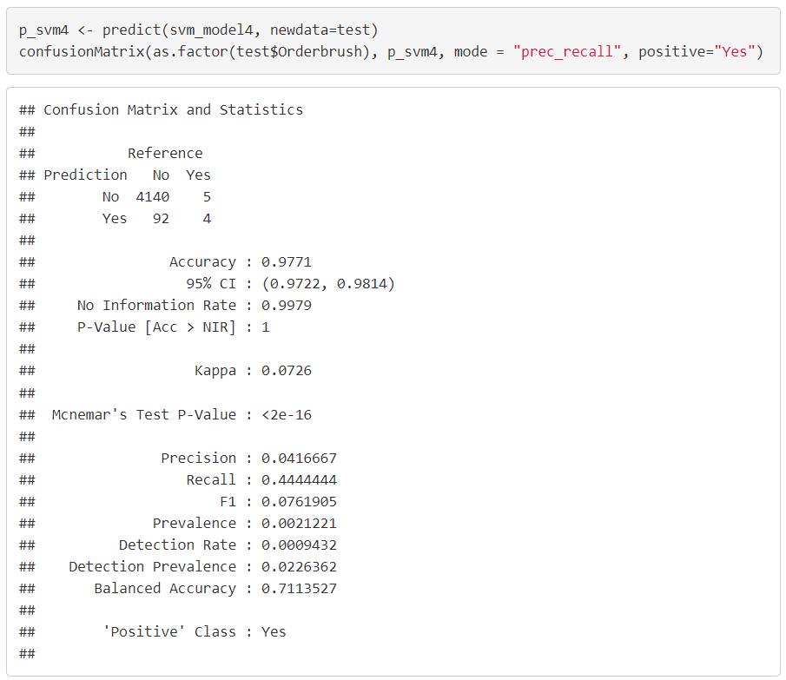
Support Vector Machines: Model Accuracy
Out of 96 "Yes", the model predicted 4 "Yes".
Precision: 0.04166
Recall: 0.44444

Slide 45
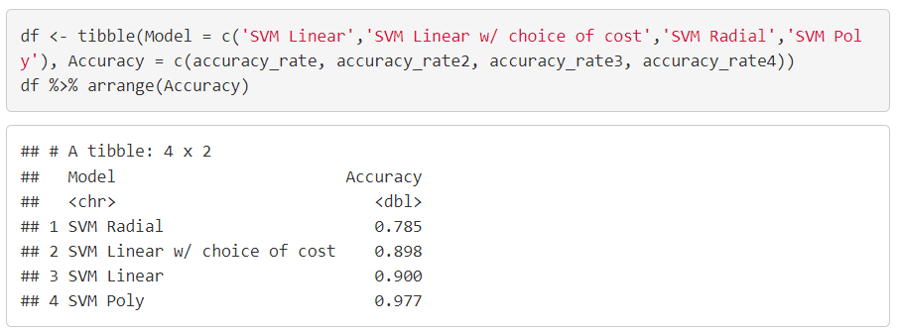
Support Vector Machines: Model Accuracy Comparison
It shown that the SVM classifier using non-linear kernel Radial gives a better result compared to the linear model.

Slide 46
Support Vector Machines: Model Limitation
Inefficient, need to perform different kernel functions to choose an appropriate function.
Long training time on large dataset.

Slide 47

Random Forest
Provides an improvement over bagged trees by way of a small tweak that decorrelates the trees
Each time a tree is split, a random sample of m predictors is taken at each split

Slide 48
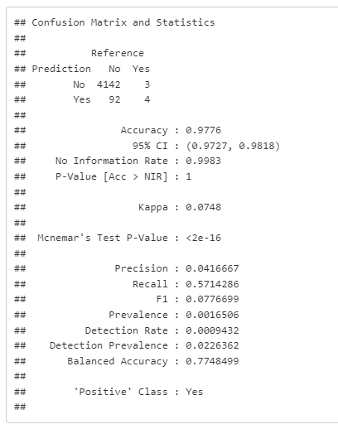
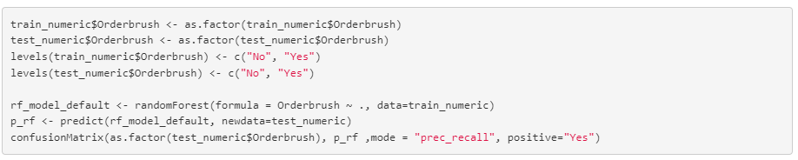
Random Forest: Baseline – Train Test
We will first create a baseline model.
This model will be trained using a simple 75-25 split in our original dataset using all available predictors.
Our model performed poorly with precision at 0.04 and f1 score 0.077.
Only predicted 4/96 order brushers.
Perfect to use as our baseline (poor) model
Notes:
#concatenate shopid and userid
orderBrush1 <- orderBrush
orderBrush1$shopid_userid <- paste(orderBrush1$shopid,orderBrush1$userid, sep = "")
#set event_time as date and time format
orderBrush1$event_time <- as.POSIXlt(orderBrush1$event_time)
#order the column shopid_userid by ascending order
orderBrush1 <- orderBrush1[order(orderBrush1$shopid_userid),]
#find duplicated shopid_userid
orderBrush1$duplicate <- duplicated(orderBrush1$shopid_userid) | duplicated(orderBrush1$shopid_userid, fromLast = TRUE)
#find those shopid_userid that with multiple orders place
orderBrush_multipleorder <- orderBrush1[orderBrush1$duplicate == TRUE,]
#find frequency of order for the shopid_userid
freq_orderBrush_multipleorder <- as.data.frame(table(orderBrush_multipleorder$shopid_userid))
colnames(freq_orderBrush_multipleorder) <- c("shopid_userid", "frequency")
orderBrush_multipleorder_freq <- merge(x = orderBrush_multipleorder, y = freq_orderBrush_multipleorder,
by = "shopid_userid")
#find those with more than 3 orders
orderBrush_multipleorder_freq <- orderBrush_multipleorder_freq[orderBrush_multipleorder_freq$frequency >= 3,]
#find the time different between each row (in seconds), assign zero to first row
orderBrush_multipleorder_freq$diff_time <- c(0, diff(orderBrush_multipleorder_freq$event_time))
#identify those order that place within an hour (3600 seconds)
#1 mean order place within an hour
#0 mean order place not wihitn an hour
for(i in 1:length(orderBrush_multipleorder_freq$diff_time)){
if( orderBrush_multipleorder_freq$diff_time[i] >= -3600 && orderBrush_multipleorder_freq$diff_time[i] <= 3600){
orderBrush_multipleorder_freq$brushing[i] <- 1
} else {
orderBrush_multipleorder_freq$brushing[i] <- 0
}
}
#only orders that being identify as brushing
orderBrush2 <- orderBrush_multipleorder_freq[orderBrush_multipleorder_freq$brushing == 1,]
#find the frequency of shopid_userid
freq_orderBrush2 <- as.data.frame(table(orderBrush2$shopid_userid))
colnames(freq_orderBrush2) <- c("shopid_userid", "frequency")
freq_orderBrush2 <- merge(x = orderBrush2, y = freq_orderBrush2,
by = "shopid_userid")
#find order with frequency more than equal to 2
#this is because those with frequency 1 should not be brushing
freq_orderBrush2 <- freq_orderBrush2[freq_orderBrush2$frequency.y >= 2,]
#total 743 group of order brushing
unique(freq_orderBrush2$shopid_userid)
#total 388 shops that suspect to have order brushing
unique(freq_orderBrush2$shopid)
#total 673 users that suspect to have order brushing
unique(freq_orderBrush2$userid)

Slide 49
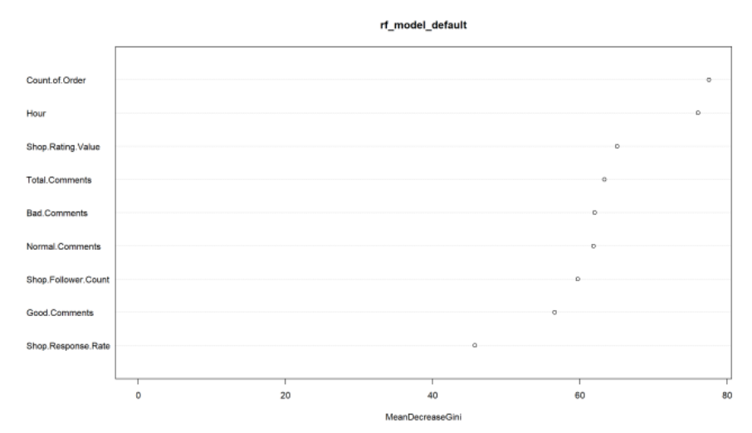
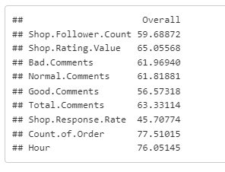
Random Forest: Baseline – Train Test
We will glance at the variable importance to estimate what are the strong predictors from this model
Notes:
#concatenate shopid and userid
orderBrush1 <- orderBrush
orderBrush1$shopid_userid <- paste(orderBrush1$shopid,orderBrush1$userid, sep = "")
#set event_time as date and time format
orderBrush1$event_time <- as.POSIXlt(orderBrush1$event_time)
#order the column shopid_userid by ascending order
orderBrush1 <- orderBrush1[order(orderBrush1$shopid_userid),]
#find duplicated shopid_userid
orderBrush1$duplicate <- duplicated(orderBrush1$shopid_userid) | duplicated(orderBrush1$shopid_userid, fromLast = TRUE)
#find those shopid_userid that with multiple orders place
orderBrush_multipleorder <- orderBrush1[orderBrush1$duplicate == TRUE,]
#find frequency of order for the shopid_userid
freq_orderBrush_multipleorder <- as.data.frame(table(orderBrush_multipleorder$shopid_userid))
colnames(freq_orderBrush_multipleorder) <- c("shopid_userid", "frequency")
orderBrush_multipleorder_freq <- merge(x = orderBrush_multipleorder, y = freq_orderBrush_multipleorder,
by = "shopid_userid")
#find those with more than 3 orders
orderBrush_multipleorder_freq <- orderBrush_multipleorder_freq[orderBrush_multipleorder_freq$frequency >= 3,]
#find the time different between each row (in seconds), assign zero to first row
orderBrush_multipleorder_freq$diff_time <- c(0, diff(orderBrush_multipleorder_freq$event_time))
#identify those order that place within an hour (3600 seconds)
#1 mean order place within an hour
#0 mean order place not wihitn an hour
for(i in 1:length(orderBrush_multipleorder_freq$diff_time)){
if( orderBrush_multipleorder_freq$diff_time[i] >= -3600 && orderBrush_multipleorder_freq$diff_time[i] <= 3600){
orderBrush_multipleorder_freq$brushing[i] <- 1
} else {
orderBrush_multipleorder_freq$brushing[i] <- 0
}
}
#only orders that being identify as brushing
orderBrush2 <- orderBrush_multipleorder_freq[orderBrush_multipleorder_freq$brushing == 1,]
#find the frequency of shopid_userid
freq_orderBrush2 <- as.data.frame(table(orderBrush2$shopid_userid))
colnames(freq_orderBrush2) <- c("shopid_userid", "frequency")
freq_orderBrush2 <- merge(x = orderBrush2, y = freq_orderBrush2,
by = "shopid_userid")
#find order with frequency more than equal to 2
#this is because those with frequency 1 should not be brushing
freq_orderBrush2 <- freq_orderBrush2[freq_orderBrush2$frequency.y >= 2,]
#total 743 group of order brushing
unique(freq_orderBrush2$shopid_userid)
#total 388 shops that suspect to have order brushing
unique(freq_orderBrush2$shopid)
#total 673 users that suspect to have order brushing
unique(freq_orderBrush2$userid)

Slide 50
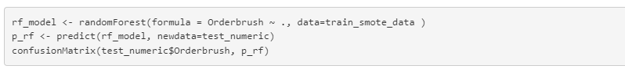
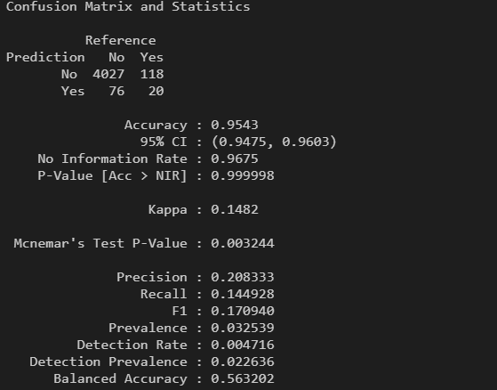
Random Forest: SMOTE
Given that our data-set is highly imbalanced at a 45:1 ratio
We will improve the baseline model by introducing SMOTE – An Under-sampling + Over-sampling technique aimed to balance our dataset.
We can see that there is an improvement in our model at 20/96 correct predictions.
Notes:
#concatenate shopid and userid
orderBrush1 <- orderBrush
orderBrush1$shopid_userid <- paste(orderBrush1$shopid,orderBrush1$userid, sep = "")
#set event_time as date and time format
orderBrush1$event_time <- as.POSIXlt(orderBrush1$event_time)
#order the column shopid_userid by ascending order
orderBrush1 <- orderBrush1[order(orderBrush1$shopid_userid),]
#find duplicated shopid_userid
orderBrush1$duplicate <- duplicated(orderBrush1$shopid_userid) | duplicated(orderBrush1$shopid_userid, fromLast = TRUE)
#find those shopid_userid that with multiple orders place
orderBrush_multipleorder <- orderBrush1[orderBrush1$duplicate == TRUE,]
#find frequency of order for the shopid_userid
freq_orderBrush_multipleorder <- as.data.frame(table(orderBrush_multipleorder$shopid_userid))
colnames(freq_orderBrush_multipleorder) <- c("shopid_userid", "frequency")
orderBrush_multipleorder_freq <- merge(x = orderBrush_multipleorder, y = freq_orderBrush_multipleorder,
by = "shopid_userid")
#find those with more than 3 orders
orderBrush_multipleorder_freq <- orderBrush_multipleorder_freq[orderBrush_multipleorder_freq$frequency >= 3,]
#find the time different between each row (in seconds), assign zero to first row
orderBrush_multipleorder_freq$diff_time <- c(0, diff(orderBrush_multipleorder_freq$event_time))
#identify those order that place within an hour (3600 seconds)
#1 mean order place within an hour
#0 mean order place not wihitn an hour
for(i in 1:length(orderBrush_multipleorder_freq$diff_time)){
if( orderBrush_multipleorder_freq$diff_time[i] >= -3600 && orderBrush_multipleorder_freq$diff_time[i] <= 3600){
orderBrush_multipleorder_freq$brushing[i] <- 1
} else {
orderBrush_multipleorder_freq$brushing[i] <- 0
}
}
#only orders that being identify as brushing
orderBrush2 <- orderBrush_multipleorder_freq[orderBrush_multipleorder_freq$brushing == 1,]
#find the frequency of shopid_userid
freq_orderBrush2 <- as.data.frame(table(orderBrush2$shopid_userid))
colnames(freq_orderBrush2) <- c("shopid_userid", "frequency")
freq_orderBrush2 <- merge(x = orderBrush2, y = freq_orderBrush2,
by = "shopid_userid")
#find order with frequency more than equal to 2
#this is because those with frequency 1 should not be brushing
freq_orderBrush2 <- freq_orderBrush2[freq_orderBrush2$frequency.y >= 2,]
#total 743 group of order brushing
unique(freq_orderBrush2$shopid_userid)
#total 388 shops that suspect to have order brushing
unique(freq_orderBrush2$shopid)
#total 673 users that suspect to have order brushing
unique(freq_orderBrush2$userid)

Slide 51
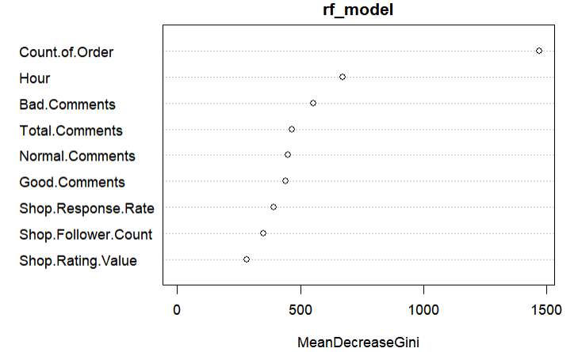
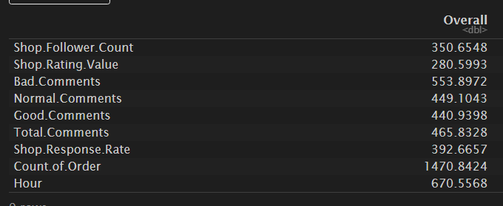
Random Forest: SMOTE
We will look at the variable importance output from this model.
All predictors saw an improvement in the mean decrease Gini coefficient.
Count of order saw a big improvement
We suspect that the creation of synthetic data has artificially created too much importance in one single variable predictor.
Notes:
#concatenate shopid and userid
orderBrush1 <- orderBrush
orderBrush1$shopid_userid <- paste(orderBrush1$shopid,orderBrush1$userid, sep = "")
#set event_time as date and time format
orderBrush1$event_time <- as.POSIXlt(orderBrush1$event_time)
#order the column shopid_userid by ascending order
orderBrush1 <- orderBrush1[order(orderBrush1$shopid_userid),]
#find duplicated shopid_userid
orderBrush1$duplicate <- duplicated(orderBrush1$shopid_userid) | duplicated(orderBrush1$shopid_userid, fromLast = TRUE)
#find those shopid_userid that with multiple orders place
orderBrush_multipleorder <- orderBrush1[orderBrush1$duplicate == TRUE,]
#find frequency of order for the shopid_userid
freq_orderBrush_multipleorder <- as.data.frame(table(orderBrush_multipleorder$shopid_userid))
colnames(freq_orderBrush_multipleorder) <- c("shopid_userid", "frequency")
orderBrush_multipleorder_freq <- merge(x = orderBrush_multipleorder, y = freq_orderBrush_multipleorder,
by = "shopid_userid")
#find those with more than 3 orders
orderBrush_multipleorder_freq <- orderBrush_multipleorder_freq[orderBrush_multipleorder_freq$frequency >= 3,]
#find the time different between each row (in seconds), assign zero to first row
orderBrush_multipleorder_freq$diff_time <- c(0, diff(orderBrush_multipleorder_freq$event_time))
#identify those order that place within an hour (3600 seconds)
#1 mean order place within an hour
#0 mean order place not wihitn an hour
for(i in 1:length(orderBrush_multipleorder_freq$diff_time)){
if( orderBrush_multipleorder_freq$diff_time[i] >= -3600 && orderBrush_multipleorder_freq$diff_time[i] <= 3600){
orderBrush_multipleorder_freq$brushing[i] <- 1
} else {
orderBrush_multipleorder_freq$brushing[i] <- 0
}
}
#only orders that being identify as brushing
orderBrush2 <- orderBrush_multipleorder_freq[orderBrush_multipleorder_freq$brushing == 1,]
#find the frequency of shopid_userid
freq_orderBrush2 <- as.data.frame(table(orderBrush2$shopid_userid))
colnames(freq_orderBrush2) <- c("shopid_userid", "frequency")
freq_orderBrush2 <- merge(x = orderBrush2, y = freq_orderBrush2,
by = "shopid_userid")
#find order with frequency more than equal to 2
#this is because those with frequency 1 should not be brushing
freq_orderBrush2 <- freq_orderBrush2[freq_orderBrush2$frequency.y >= 2,]
#total 743 group of order brushing
unique(freq_orderBrush2$shopid_userid)
#total 388 shops that suspect to have order brushing
unique(freq_orderBrush2$shopid)
#total 673 users that suspect to have order brushing
unique(freq_orderBrush2$userid)

Slide 52
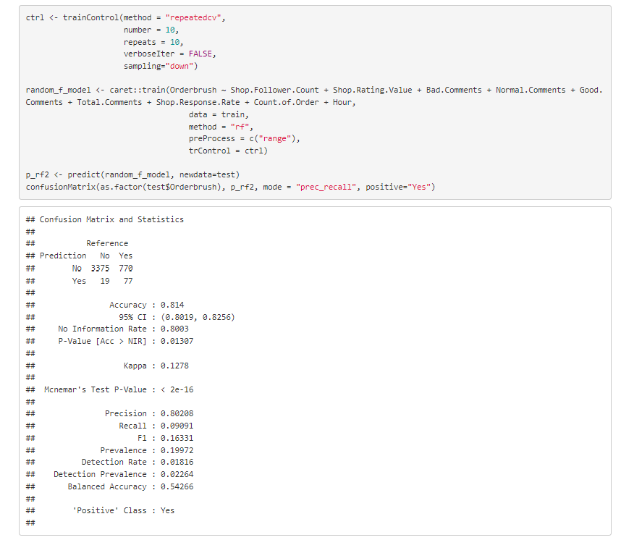
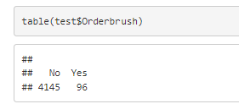
Random Forest: 10-fold CV + Under-sample + hyper-parameter tuning
Data preprocessing method : Normalization
Rather than creating synthetic positives, we will balance by reducing the negatives.
Since there are high outliers in our data, We will also do data tuning using normalization.
Normalization gives equal weights/importance to each variable so that no single variable steers model performance in one direction just because they are bigger numbers.
Notes:
#concatenate shopid and userid
orderBrush1 <- orderBrush
orderBrush1$shopid_userid <- paste(orderBrush1$shopid,orderBrush1$userid, sep = "")
#set event_time as date and time format
orderBrush1$event_time <- as.POSIXlt(orderBrush1$event_time)
#order the column shopid_userid by ascending order
orderBrush1 <- orderBrush1[order(orderBrush1$shopid_userid),]
#find duplicated shopid_userid
orderBrush1$duplicate <- duplicated(orderBrush1$shopid_userid) | duplicated(orderBrush1$shopid_userid, fromLast = TRUE)
#find those shopid_userid that with multiple orders place
orderBrush_multipleorder <- orderBrush1[orderBrush1$duplicate == TRUE,]
#find frequency of order for the shopid_userid
freq_orderBrush_multipleorder <- as.data.frame(table(orderBrush_multipleorder$shopid_userid))
colnames(freq_orderBrush_multipleorder) <- c("shopid_userid", "frequency")
orderBrush_multipleorder_freq <- merge(x = orderBrush_multipleorder, y = freq_orderBrush_multipleorder,
by = "shopid_userid")
#find those with more than 3 orders
orderBrush_multipleorder_freq <- orderBrush_multipleorder_freq[orderBrush_multipleorder_freq$frequency >= 3,]
#find the time different between each row (in seconds), assign zero to first row
orderBrush_multipleorder_freq$diff_time <- c(0, diff(orderBrush_multipleorder_freq$event_time))
#identify those order that place within an hour (3600 seconds)
#1 mean order place within an hour
#0 mean order place not wihitn an hour
for(i in 1:length(orderBrush_multipleorder_freq$diff_time)){
if( orderBrush_multipleorder_freq$diff_time[i] >= -3600 && orderBrush_multipleorder_freq$diff_time[i] <= 3600){
orderBrush_multipleorder_freq$brushing[i] <- 1
} else {
orderBrush_multipleorder_freq$brushing[i] <- 0
}
}
#only orders that being identify as brushing
orderBrush2 <- orderBrush_multipleorder_freq[orderBrush_multipleorder_freq$brushing == 1,]
#find the frequency of shopid_userid
freq_orderBrush2 <- as.data.frame(table(orderBrush2$shopid_userid))
colnames(freq_orderBrush2) <- c("shopid_userid", "frequency")
freq_orderBrush2 <- merge(x = orderBrush2, y = freq_orderBrush2,
by = "shopid_userid")
#find order with frequency more than equal to 2
#this is because those with frequency 1 should not be brushing
freq_orderBrush2 <- freq_orderBrush2[freq_orderBrush2$frequency.y >= 2,]
#total 743 group of order brushing
unique(freq_orderBrush2$shopid_userid)
#total 388 shops that suspect to have order brushing
unique(freq_orderBrush2$shopid)
#total 673 users that suspect to have order brushing
unique(freq_orderBrush2$userid)

Slide 53
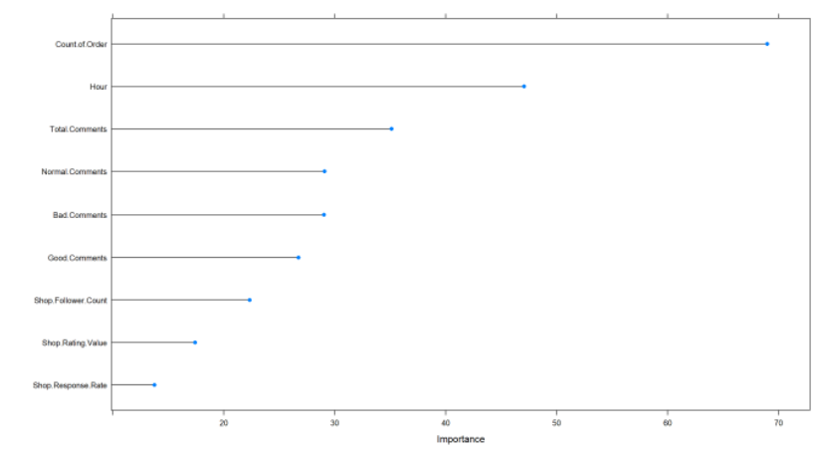
Random Forest: Model Accuracy
77/96 correctly predicted positives
Precision score 0.802
Low recall score 0.09
Notes:
#concatenate shopid and userid
orderBrush1 <- orderBrush
orderBrush1$shopid_userid <- paste(orderBrush1$shopid,orderBrush1$userid, sep = "")
#set event_time as date and time format
orderBrush1$event_time <- as.POSIXlt(orderBrush1$event_time)
#order the column shopid_userid by ascending order
orderBrush1 <- orderBrush1[order(orderBrush1$shopid_userid),]
#find duplicated shopid_userid
orderBrush1$duplicate <- duplicated(orderBrush1$shopid_userid) | duplicated(orderBrush1$shopid_userid, fromLast = TRUE)
#find those shopid_userid that with multiple orders place
orderBrush_multipleorder <- orderBrush1[orderBrush1$duplicate == TRUE,]
#find frequency of order for the shopid_userid
freq_orderBrush_multipleorder <- as.data.frame(table(orderBrush_multipleorder$shopid_userid))
colnames(freq_orderBrush_multipleorder) <- c("shopid_userid", "frequency")
orderBrush_multipleorder_freq <- merge(x = orderBrush_multipleorder, y = freq_orderBrush_multipleorder,
by = "shopid_userid")
#find those with more than 3 orders
orderBrush_multipleorder_freq <- orderBrush_multipleorder_freq[orderBrush_multipleorder_freq$frequency >= 3,]
#find the time different between each row (in seconds), assign zero to first row
orderBrush_multipleorder_freq$diff_time <- c(0, diff(orderBrush_multipleorder_freq$event_time))
#identify those order that place within an hour (3600 seconds)
#1 mean order place within an hour
#0 mean order place not wihitn an hour
for(i in 1:length(orderBrush_multipleorder_freq$diff_time)){
if( orderBrush_multipleorder_freq$diff_time[i] >= -3600 && orderBrush_multipleorder_freq$diff_time[i] <= 3600){
orderBrush_multipleorder_freq$brushing[i] <- 1
} else {
orderBrush_multipleorder_freq$brushing[i] <- 0
}
}
#only orders that being identify as brushing
orderBrush2 <- orderBrush_multipleorder_freq[orderBrush_multipleorder_freq$brushing == 1,]
#find the frequency of shopid_userid
freq_orderBrush2 <- as.data.frame(table(orderBrush2$shopid_userid))
colnames(freq_orderBrush2) <- c("shopid_userid", "frequency")
freq_orderBrush2 <- merge(x = orderBrush2, y = freq_orderBrush2,
by = "shopid_userid")
#find order with frequency more than equal to 2
#this is because those with frequency 1 should not be brushing
freq_orderBrush2 <- freq_orderBrush2[freq_orderBrush2$frequency.y >= 2,]
#total 743 group of order brushing
unique(freq_orderBrush2$shopid_userid)
#total 388 shops that suspect to have order brushing
unique(freq_orderBrush2$shopid)
#total 673 users that suspect to have order brushing
unique(freq_orderBrush2$userid)

Slide 54
Random Forest: Model Limitation
Large number of trees can make the algorithm too slow and ineffective for real-time predictions.
Not good for comprehensibility. Hard to visualize predictions

Slide 55

Naive Bayes
Models each quantitative feature using a Gaussian distribution

Slide 56
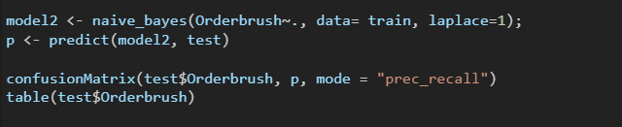
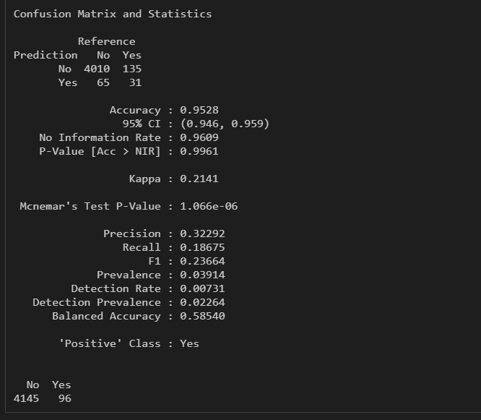
Naive Bayes
Prediction results: 31/96
Precision: 0.32
Recall: 0.186 (Relatively higher than rest)

Slide 57
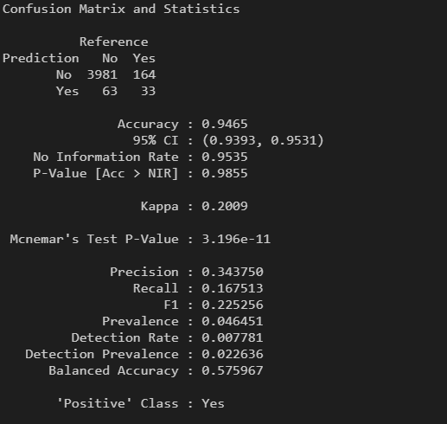
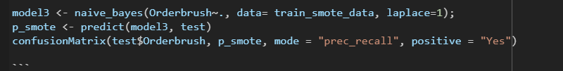
Naive Bayes (SMOTE)
Prediction results: 33/96
Precision: 0.34
Recall: 0.167 (Went down)

Slide 58

Model Comparison
Notes:
Describe the modeling techniques used (e.g. regression, classification,
clustering).
• Compare and contrast different modeling algorithms.
• Explain and discuss the experimental results.
• Discuss any limitations of the approach

Slide 59
Model Comparison
 | Logistics Regression | Support Vector Machine | Random Forest | Naïve Bayes
Predicted Yes | 61/96 | 70/96 | 77/96 | 31/96
Precision | 0.63542 | 0.72917 | 0.80208 | 0.32292
Recall | 0.09935 | 0.07315 | 0.09091 | 0.18675

Slide 60

Conclusion
Challenges, learning points and future improvements
Notes:
Discuss any learning points.
• Suggest possible future improvements

Slide 61
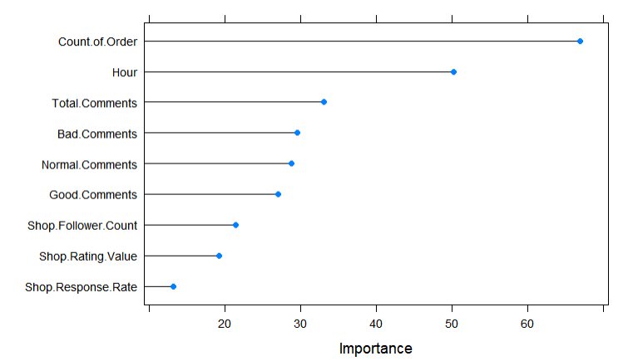
Inference
We were expecting Shop rating value to be the strong predictor for order brushing since their objective was to drive up their ratings. (given that 99% have above average ratings)
Total comments and Bad comments rose as the strong variable predictors.
Implying that organic buyers are giving bad comments for the product sold by the order-brushing shops.

Slide 62

Learning Points
Managing expectations and trade-offs.
When we try to prevent more fraud, will increase number of non-fraud sellers to be blocked.
If we reduce the number of false positives (non-fraud sellers blocked), more fraud sellers will slip through
Businesses need to decide how to balance the two

Slide 63
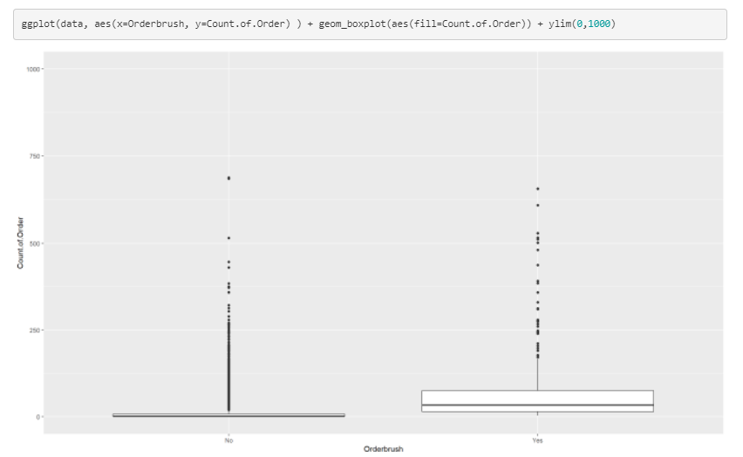
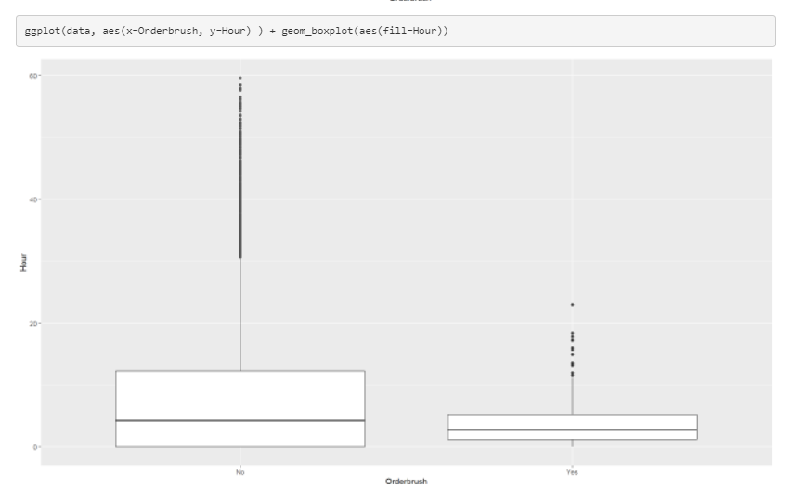
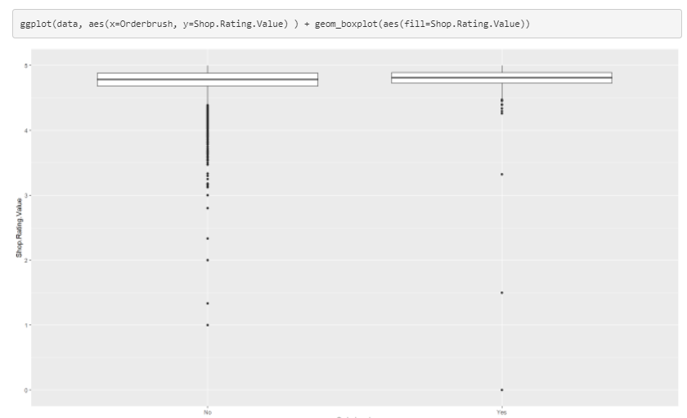
Challenges
Low recall score. High number of false positives.
Suggest to feature engineering of more data for more variables
Poor quality data
Inputs may be flawed, which may result in unreliable output
High number of outliers
Notes:
Discuss any learning points.
• Suggest possible future improvements
Overfitting/underfitting etc

Slide 64

Challenges
Data extraction
Meaningful and real-time data are not readily available and have to be extracted via means such as API
Inaccessible data due to privacy concerns

Slide 65
Future Improvements
More available API to call such as shop product category
Feature engineer for more predictors to identify order brusher
Dataset over longer period to identify order brusher
We will have more fraud positive dataset which increases the accuracy of the model

Slide 66

The End
Thank you

